Slide 1

Programa de Pós Graduação em Computação Aplicada (PPGCA)
Stenosis Classifier Application using MQTT
Samuel Armbrust Freitas

Slide 2

Objective
Apply an IoT technique in our coronary artery disease (CAD) context visually detectable via a stenosis
Provide an application to classify coronary artery stenosis using a lightweight, publish-subscribe network protocol.
Allow the use of our trained model for classify coronary arteries using a distributed system architecture via an API model.

Slide 3
Proposal
Create a mock application to publish messages (CAD MQTT generator)
A MQTT broker application to allow the communication (MQTT Broker)
A application running a model trained for CAD classification (CAD classifier)

Slide 4



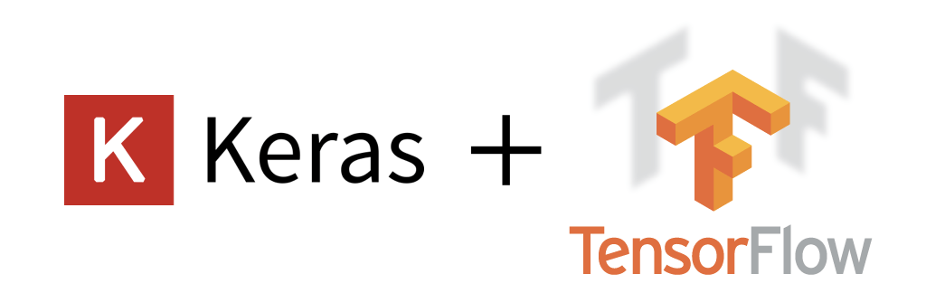
Architecture
Python and Mosquitto-based applications

Slide 5
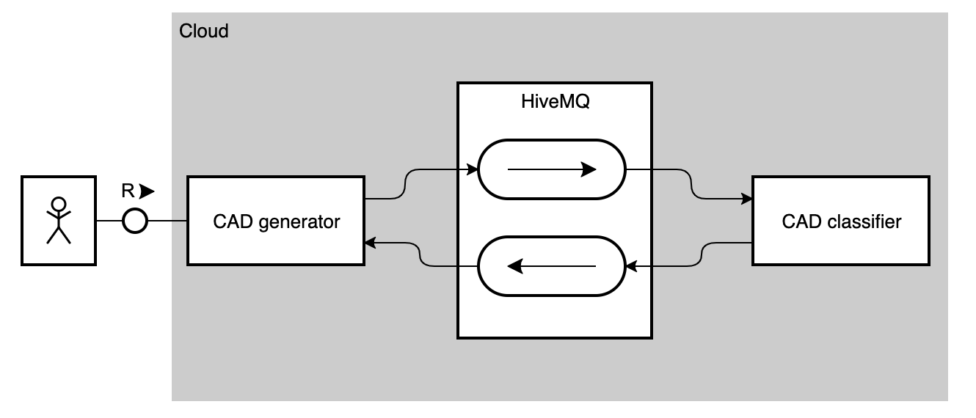
Architecture - TAM

Slide 6
Responsibilities – CAD generator
Python application
Transforming images into arrays encoded base64
Subscribed to cad-predict/# topic
Send the encoded image to the topic
---- we can have different hospitals to generate input
Protocol = MQTT

Slide 7
Responsibilities – MQTT Broker
HiveMQ is a cloud-based Mosquitto broker
Free plan available
Well-designed User Interface
Act as a Broker
Receive message
Make it available in the respective queue

Slide 8
Responsibilities – CAD classifier
Python application
Storing a model.h5 for CAD classification
Subscribe to cad-predict/#
Decode the image in base64
Predict and show the prediction result
Protocol = MQTT

Slide 9
Expected
Present an end-to-end process to predict CAD
Use of MQTT as a lightweight communication protocol (PoC)
Test the use of python as a distribution application to predict CAD

Slide 10
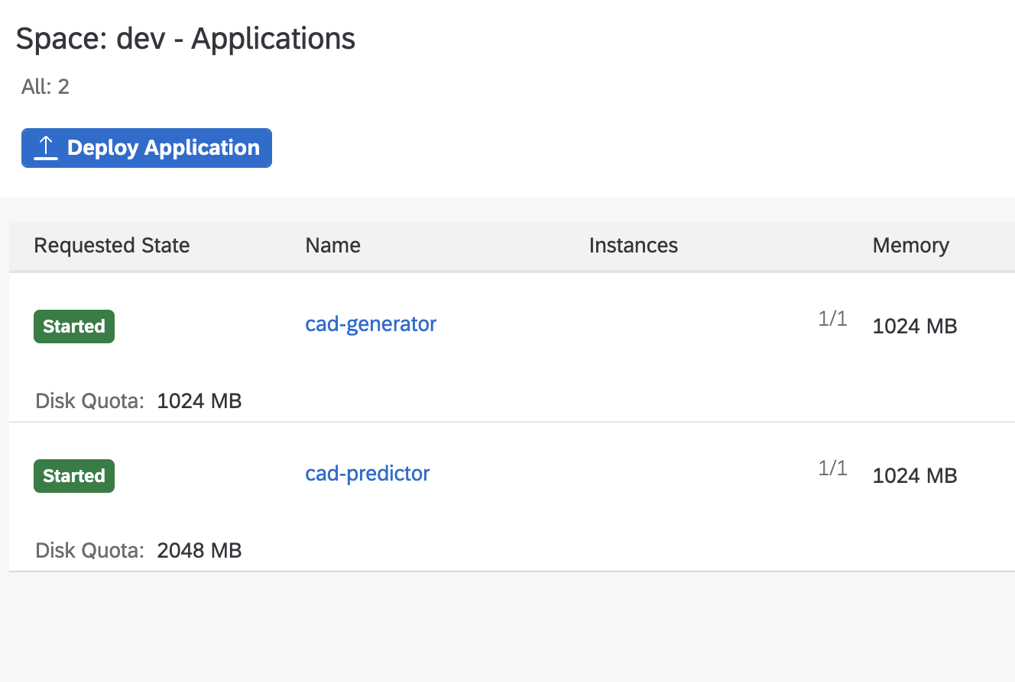
Results
SAP BTP

Slide 11
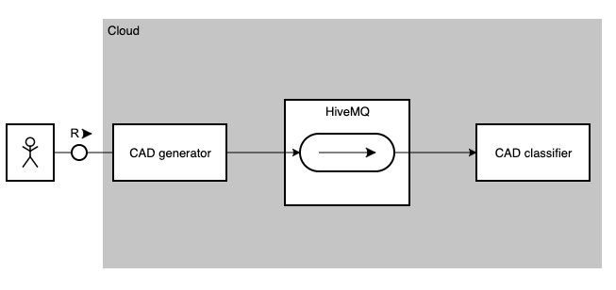
[updated] Architecture - TAM

Slide 12
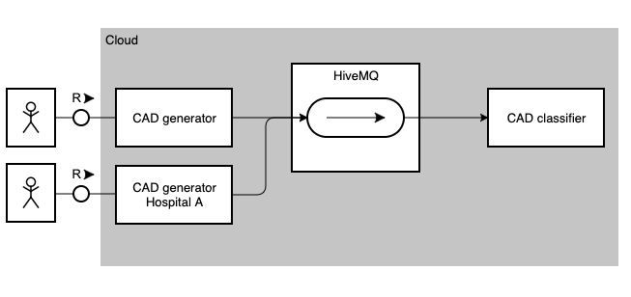
[updated] Architecture - TAM

Slide 13
Results
https://cad-generator.cfapps.us10.hana.ondemand.com/predict?img=
negative_x
positive_x
https://cad-predictor.cfapps.us10.hana.ondemand.com/result
Additional instance: https://cad-generator-hospital.cfapps.us10.hana.ondemand.com/predict?img=
Do not forget to be logging the cad-predictor to avoid memory overflow :)

Slide 14
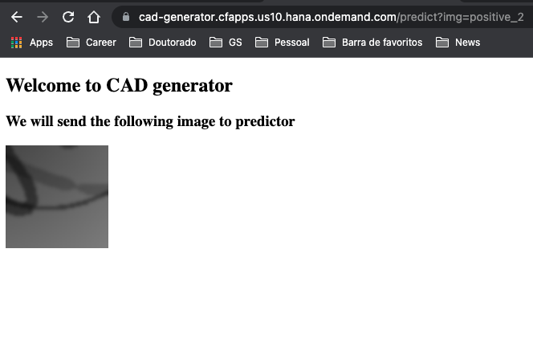
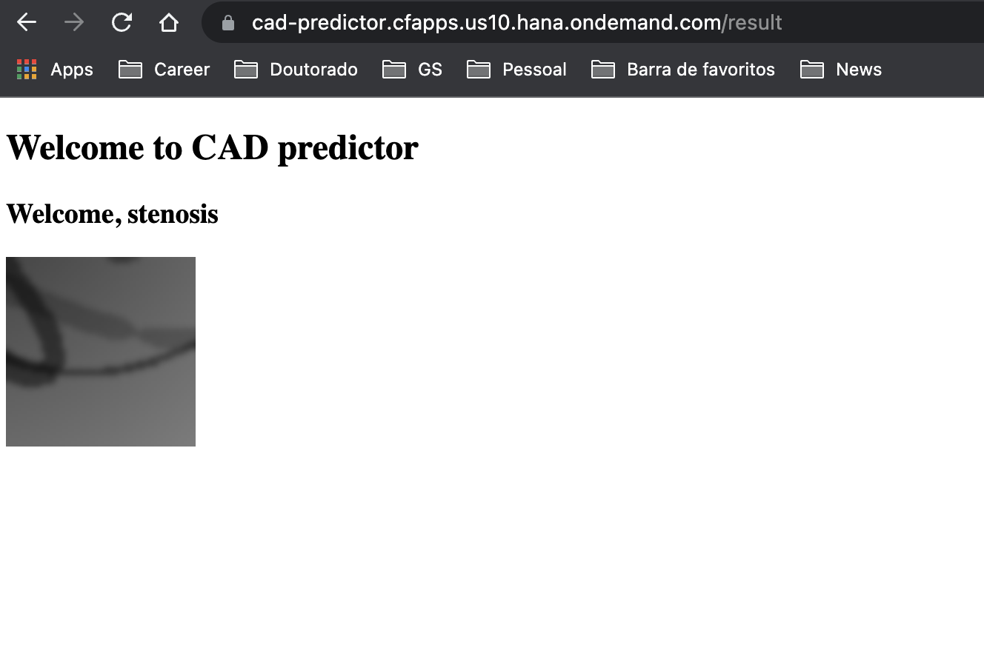
Results

Slide 15
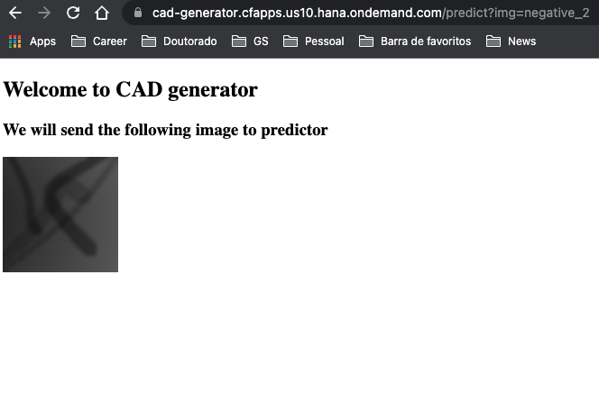
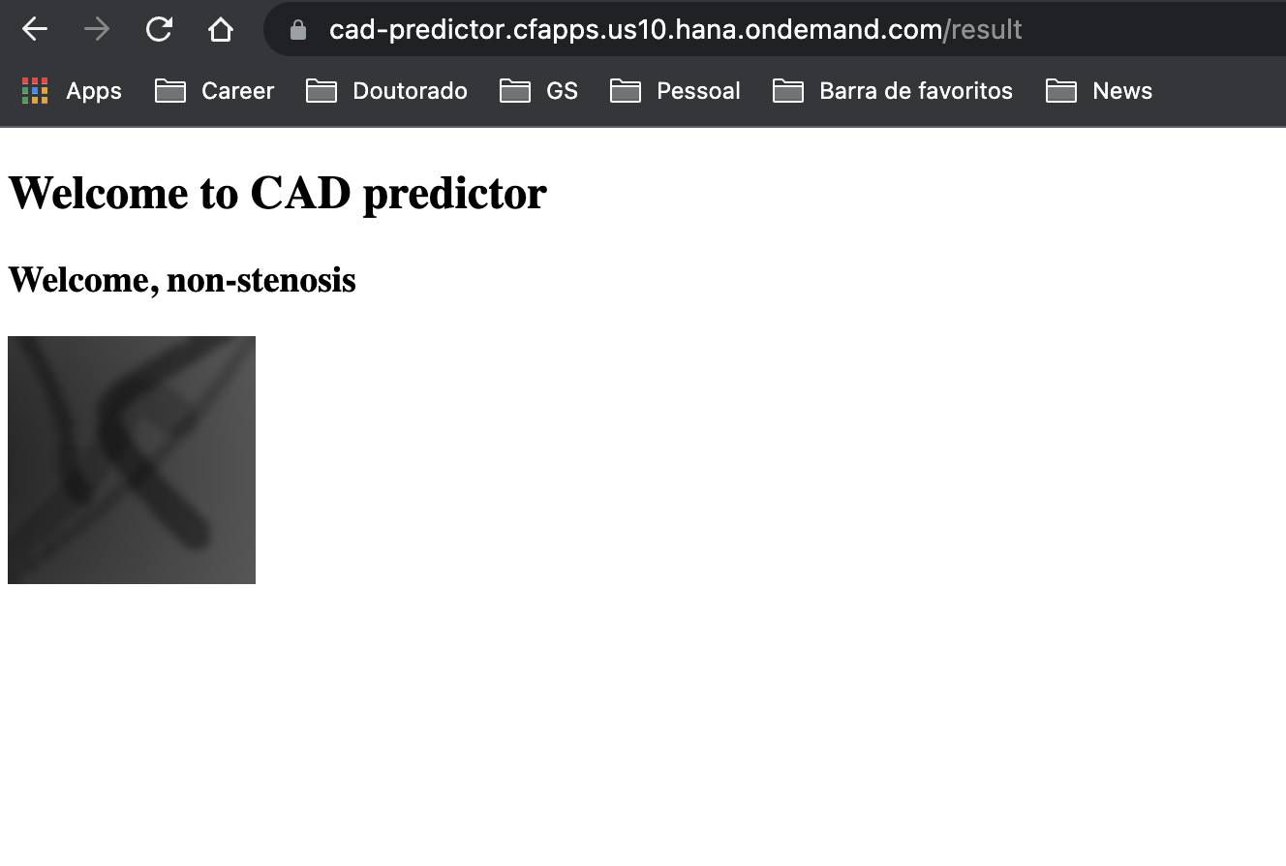
Results

Slide 16
Challenges
MQTT with python
Python with Cloud foundry
Cloud foundry with Keras
Keras with its updates ☺
Trial environment memory limitation
Simplification to proof the concept

Slide 17


Slide 18


